Slide 1



Machine Learning Hackathon
Team Name- Karasuno
Team Leader Name- Prachet Shah, Sanika Ardekar
Team Leader Email Address- prachetshah25@gmail.com

Slide 2
Brief Description of the Problem at hand:
The ad server logs contain information about user behavior, including browser details, IP addresses, geographic locations, search patterns, site URLs, and other relevant data.
The objective of the hackathon is to build a model that can accurately predict whether a user belongs to the HCP category and its specialization id/taxonomy.
The HCP category refers to the type of healthcare professional a user is.
The specialization id/taxonomy refers to the specific area of expertise of a healthcare professional.
The model will be used to target advertising to HCPs.
The problem statement is challenging because it requires the model to be able to accurately predict the HCP category and specialization id/taxonomy of a user based on a variety of different data points.
The problem statement is also very rewarding because it has the potential to make a real impact on the way that businesses target their advertising to HCPs.

Slide 3
Solution proposed and description:
Our aim in this problem statement is to classify whether the given record is HCP or not. As this is a supervised binary classification problem, we use different prominent algorithms like Decision Tree Classifier, Logistic Regression, Random Forest Classifier and XGBoost Classifier.
On comparing result on train set and evaluation score, the XGBoost Classifier with objective as binary:logistic and estimators as 500 as well as jobs=80 gave the best result. Then the predicted IS_HCP value from prev step is utilised for Taxonomy prediction which is carried out using Random Forest classifier. Predictions are made on the validation data and the test data.

Slide 4
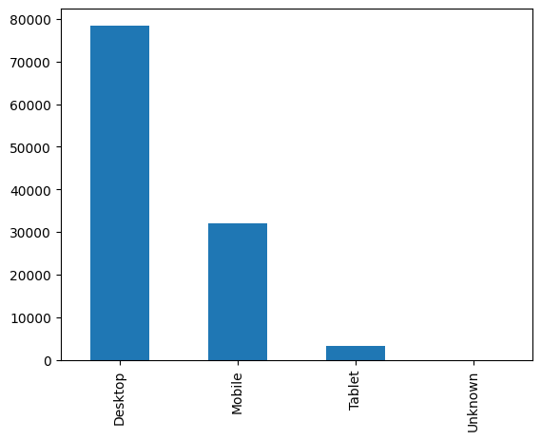

Approach:
1) Exploratory Data Analysis was conducted on the train dataset to gain insights into important and relevant columns, providing a deeper understanding of the data.
2) Word clouds were plotted using the Natural Language Toolkit (NLTK) for the 'keywords' column, considering the 'IS_HCP' parameter. Additionally, graphs were generated for various features such as 'Device Type' and 'Platform Type' using Python's built-in plot function.

Slide 5
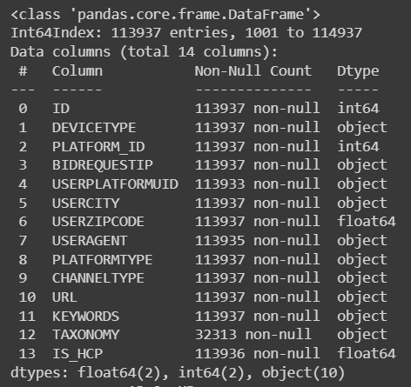
Approach(contd):
3) Missing values in columns were appropriately handled. For instance, unknown values in the 'User City' column were replaced with the mode of the column, ensuring the preservation of data distribution and characteristics. The 'Taxonomy' column's 'unknown' rows were filled based on the 'IS_HCP' values.
4) Label encoding was performed on all the columns using the sklearn library, facilitating ease in model building by converting categorical data into numerical labels.

Slide 6
Approach(contd.):
5) To prepare the dataset for modeling, the train and test datasets were concatenated into a single large dataset denoted as 'x'. Subsequently, 'x' was split into 80% for training and 20% for testing purposes.
6) Model Creation
Different classifiers are tried to see which algorithm performs the best on given data. A Logistic Regression Classifier was applied initially as it was a binary classification problem, resulting in an accuracy of 73% and an evaluation score of 45.
The Random Forest Classifier achieved a perfect accuracy of 100% but exhibited overfitting, as indicated by an evaluation score of 50. The XGBoost Classifier seemed to work best for the IS_HCP Prediction and RandomForest gave better results for TAXONOMY Prediction.

Slide 7
Approach (cont.):
6 (Continue … )
The Decision Tree Classifier also achieved a perfect accuracy of 100% but performed relatively better with an evaluation score of 59, suggesting a higher degree of generalization compared to the Random Forest Classifier.
Considering the observed overfitting, the decision was made to employ the XGBoost Classifier known for its exceptional predictive performance and ability to handle intricate datasets.
The XGBoost Classifier exhibited remarkable performance, achieving an impressive accuracy of 99.87% and a score of 99.0 on evaluation.

Slide 8
Approach (cont.):
7) Hyperparameter Tuning
Hyperparameter tuning was conducted to identify the optimal parameters for the model. Initially, Grid Search CV was attempted, but its computational expense and time consumption made it impractical due to the large hyperparameter search space and dataset size.
To address these challenges, Random Search CV was employed, which efficiently explores the hyperparameter space by random sampling. This method is particularly effective for high-dimensional search spaces. The XGBoost Classifier with the objective set as binary:logistic, 500 estimators, and 80 jobs yielded the best outcome, boasting a perfect accuracy of 100%. This optimized model further achieved a high evaluation score of 99.6382. Additionally, a Random Forest Classifier was trained on the training data, and predictions were made on the validation data for taxonomy predictions.

Slide 9
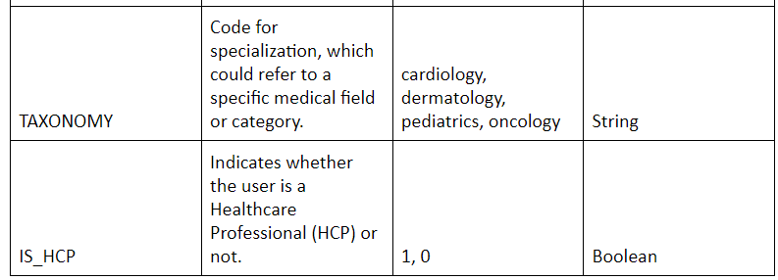
Approach (cont.):
8) Taxonomy Prediction
A Random Forest Classifier was trained on the training data and the predicted IS_HCP Data from the previous step is taken into consideration, and predictions were made on the validation data for taxonomy predictions.

Slide 10
Model Explanation (IS_HCP Prediction)
XGBClassifier(n_estimators=500, n_jobs=80, objective='binary:logistic')
Objective:
Binary Classification (predicting one of two classes)
Key Hyperparameters:
n_estimators: 500 (number of boosting rounds)
n_jobs: 80 (parallel threads during training)
objective: 'binary:logistic' (logistic regression for binary classification)
Benefits:
High Performance: Superior accuracy and efficiency
Scalability: Handles large-scale datasets
Feature Importance: Identifies influential features
Regularization: Prevents overfitting
Training: Sequentially builds 500 decision trees
Prediction: Weighted sum of tree predictions

Slide 11
Model Explanation (Taxonomy Prediction)
RandomForestClassifier(n_estimators=300, random_state=42)
Objective:
Multiple Classification (predicting multiple classes)
Key Hyperparameters:
n_estimators: 300 (number of decision trees in the forest)
random_state: 42 (seed for random number generation)
Benefits:
Ensemble Learning: Combines multiple decision trees
High Performance: Robust and accurate predictions
Parallel Processing: Efficient with large datasets
Feature Importance: Identifies important features
Reduces Overfitting: Averages predictions from trees
Training: Builds 300 decision trees independently
Prediction: Takes majority vote from all trees

Slide 12
Execution Demo (Video/ Screenshots) of the solution:
Demo Video Karasuno

Slide 13
Source code in ZIP file/Github URL:
Github Link
Doceree Karasuno Zip file link

Slide 14


